Slide 1
Team Members:
1. Nguyễn Trực Cường - 20215005 (Leader)
- Design the application’s main UI using FXML and CSS.
- Implement JavaFX controllers for the application’s components.
- Design and implement model classes(Piano, PianoKey, Recorder,…).
- Review team member codes.
- Prepare texts and image resources for application.
- Prepare report & presentation.
- Integrate Apache Maven build tool into the project.
2. Phạm Thành Công - 20194494
- Design the help menu.
- Improve UX.
- Provide suggestions for Class Diagram and Use Case Diagram.
3. Đặng Minh Chức – 20215001
- Provide suggestions for Class Diagram and Use Case Diagram.
- Prepare demo video.
4. Khổng Lê Cường - 20215004
- Prepare piano sound data
- Research audio playback methods in Java.
- Add new music styles to the application’s setting.
- Provide suggestions for Class Diagram and Use Case Diagram.
Topic 10:
Electronic Piano
Class: OOLT.VN.20231
Course: IT3103

Slide 2


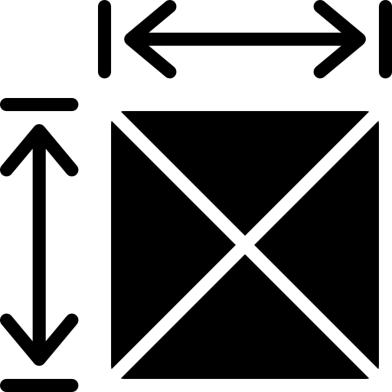

Problem statement
Physical Piano

Slide 3
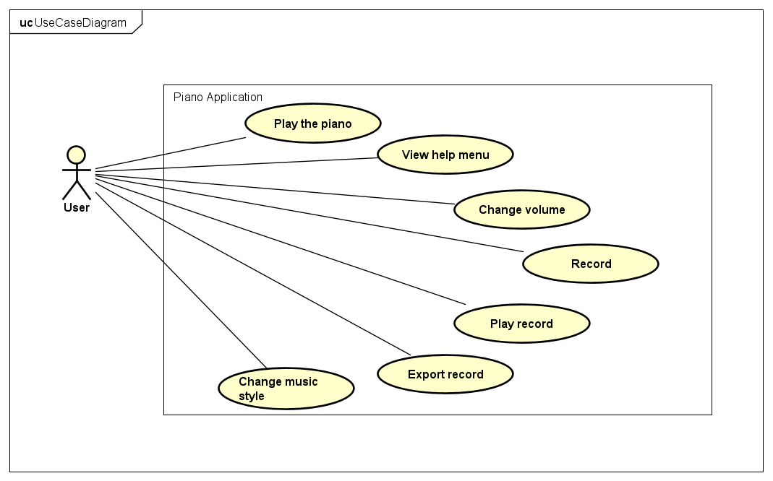
Use case diagram

Slide 4
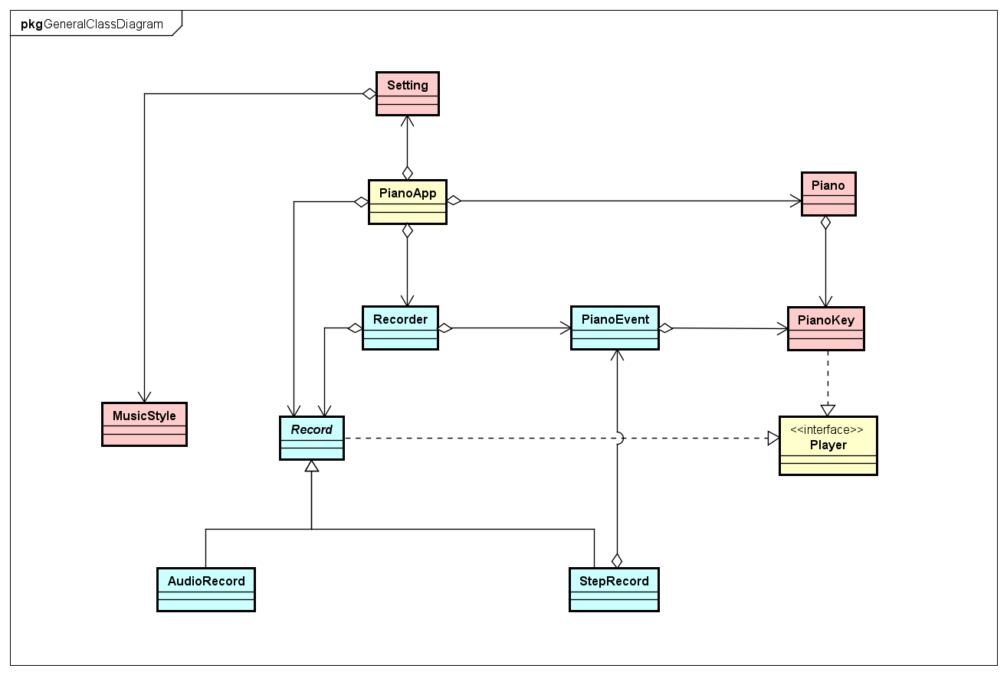
General class diagram

Slide 5
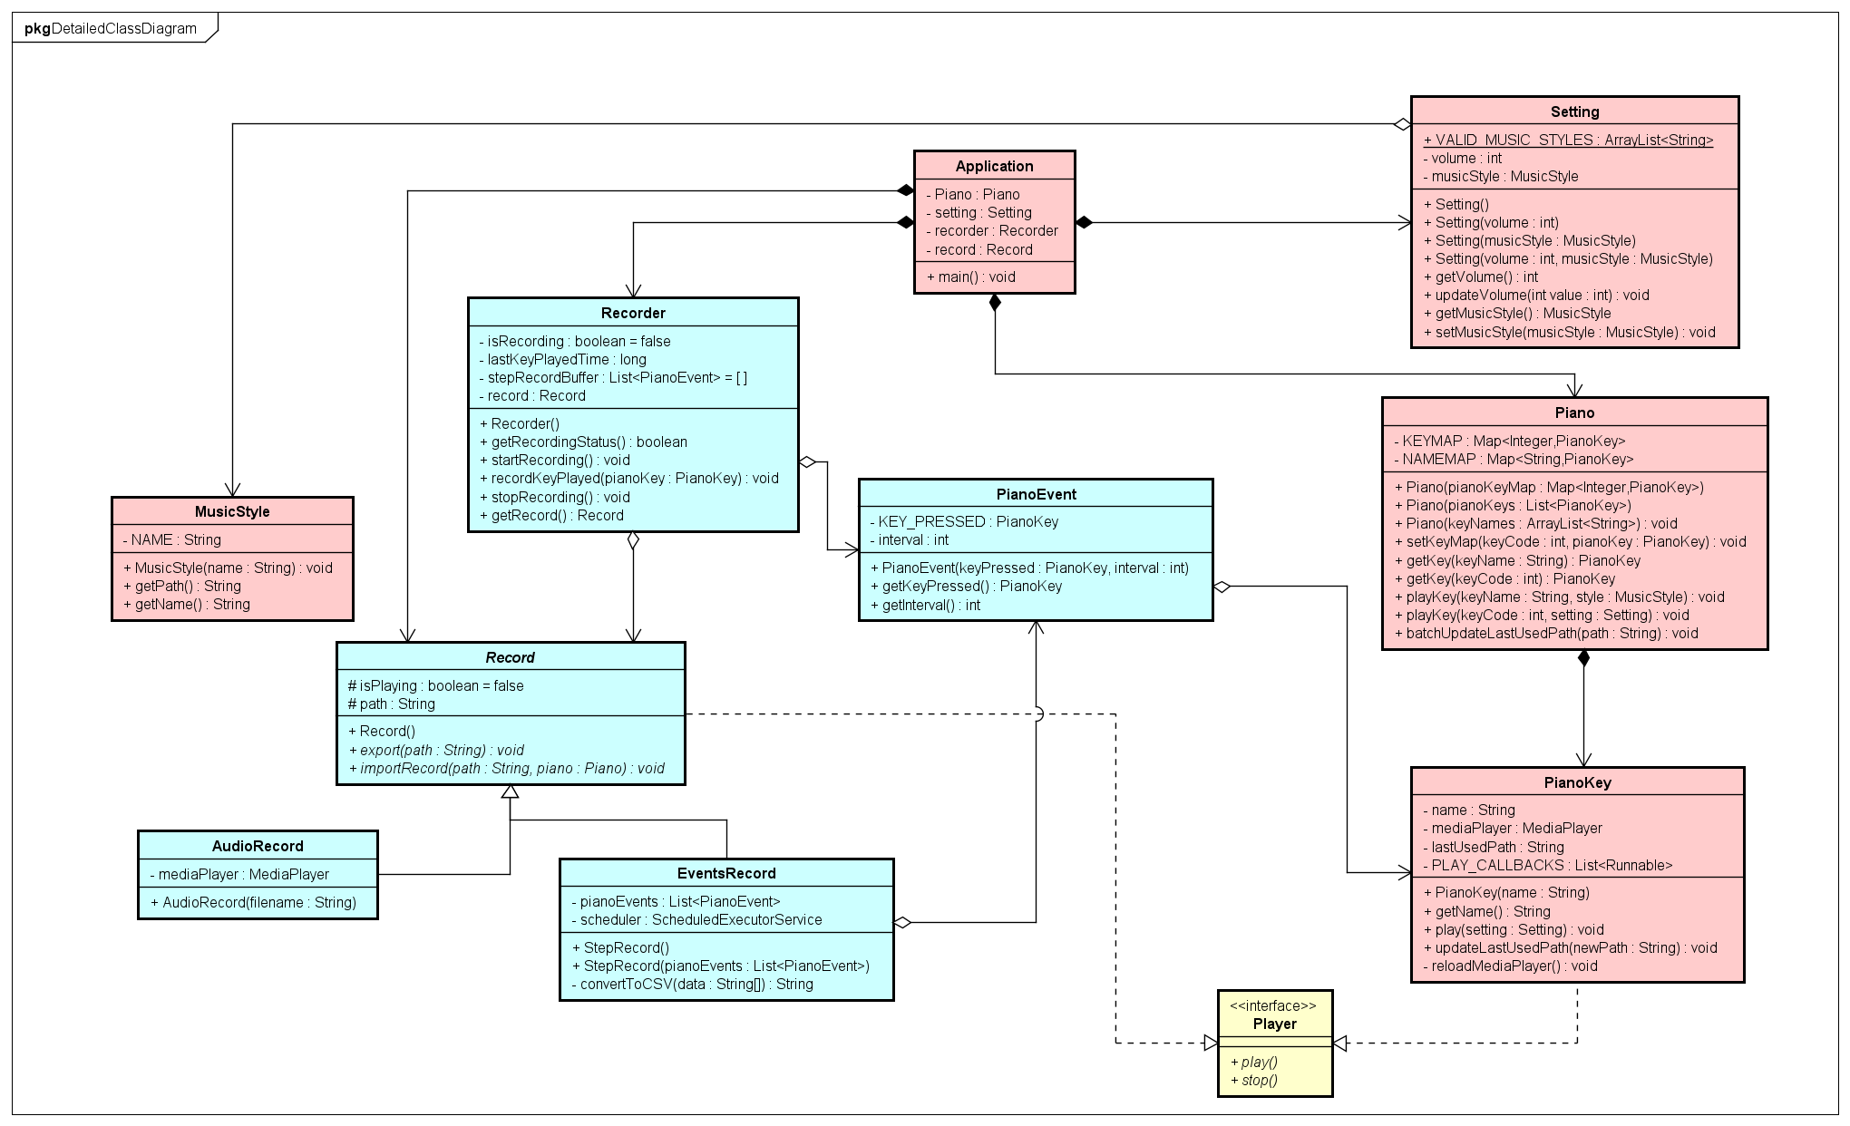
Detailed class diagram

Slide 6
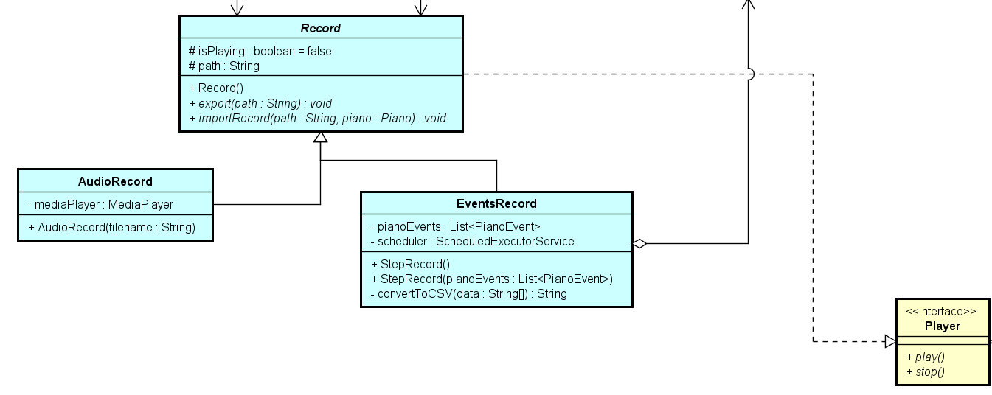
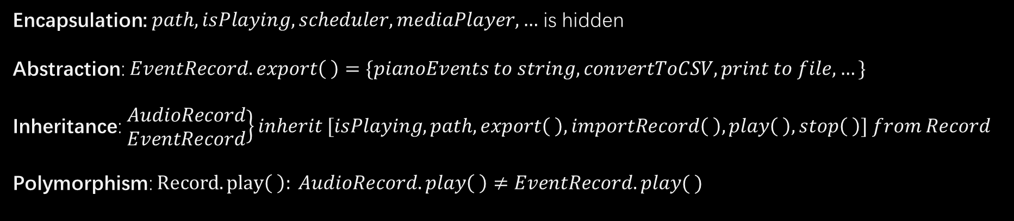
Detailed class diagram
OOP main principles
Encapsulation: $path, isPlaying, scheduler, mediaPlayer,…$ is hidden
Abstraction: $EventRecord.export\left( \right)=\{pianoEvents to string, convertToCSV, print to file, …\}$
Inheritance: $\left.\begin{aligned}AudioRecord \\ EventRecord\end{aligned}\right\}inherit [isPlaying, path, export\left( \right), importRecord\left( \right), play\left( \right), stop\left( \right)] from Record$
Polymorphism: $Record.play\left( \right): AudioRecord.play\left( \right)≠EventRecord.play( )$

Slide 7

Detailed class diagram
Composition:
$$Piano p1=\left\{\begin{aligned}PianoKey pk1 \\ PianoKey pk2 \\ PianoKey pk3 \\ …\end{aligned}\right.$$

Slide 8
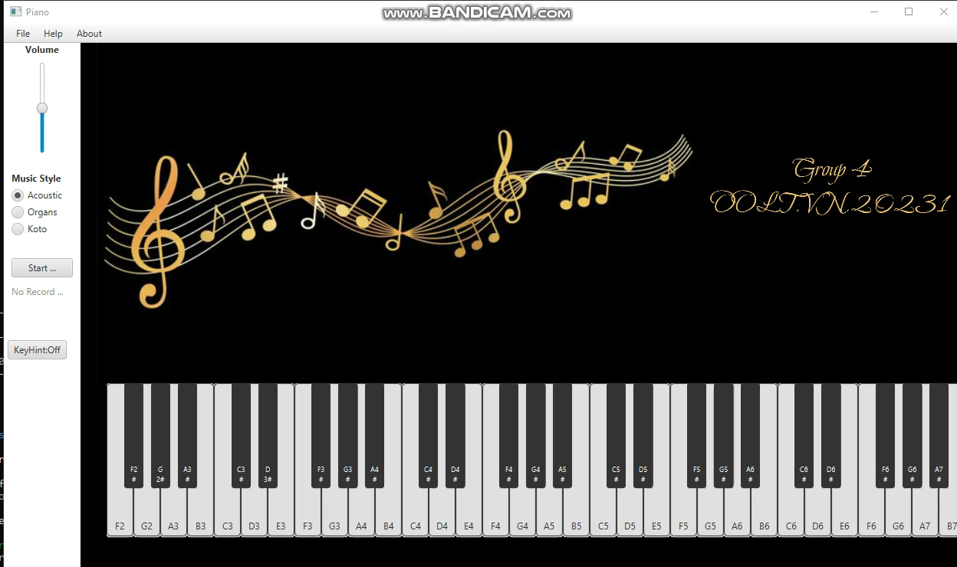
Demo

Slide 9
Thanks for listening!

